Slide 1

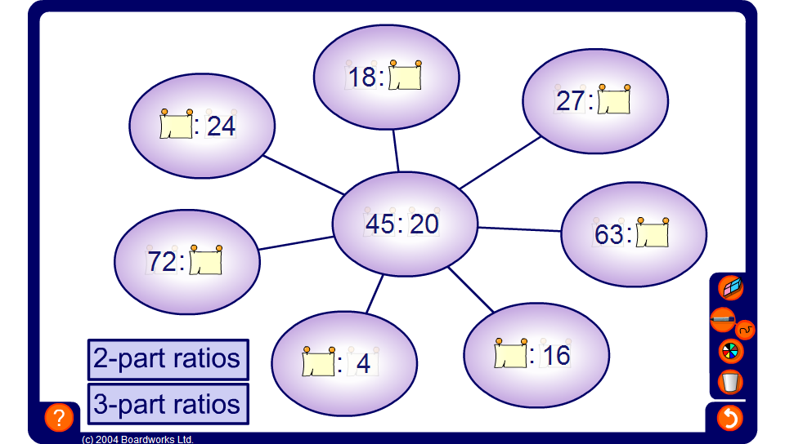


Equivalent ratio spider diagrams
Notes:
This activity develops multiplicative reasoning by asking pupils to scale between a given ratio shown in the centre and other equivalent ratios.
There are many ways to find the equivalent ratios using combinations of multiplication and division, or using a singe scale factor. Encourage pupils to discuss their methods as far as possible.
Pupils may also notice that equivalent ratios can be added or subtracted to make other equivalent ratios. For example, adding 6 : 9 to 10 : 15 makes 16 : 24.
This activity can be simplified by first asking pupils to find the ratio in its simplest form and finding this along one of the ‘spider legs’. Every other ratio can then be found by multiplying the parts of the ratio given in its simplest form by a single whole number.

